Slide 1
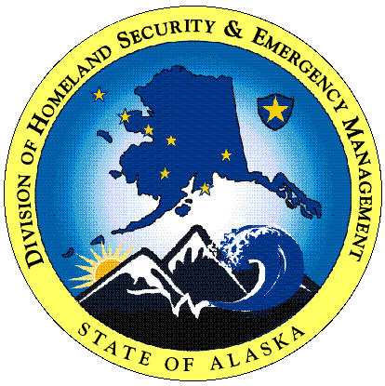

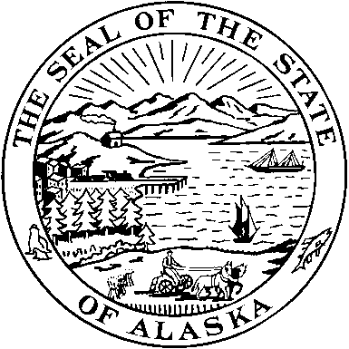
Alaska
Coastal Mapping
Safety and Security of
The People and Economy
Mike O’Hare
Department of Military & Veterans Affairs
Division of
Homeland Security & Emergency Management
Notes:
dialogue with you regarding your use of NOAA's navigation data, products, and information for the Alaska/Arctic region. panel to assess NOAA's Navigation, water level, and Geodetic products and services. In addition, we would like to hear from you about how you utilize NOAA's information to assess emergency management in Alaska as well as recommendation about how to make them better.

Slide 2
NOAA hydrographic services-geospatial, water level and navigation products/services
Tsunami Inundation Mapping that UAF/DNR produces for us/our Alaska communities; According to the Tsunami hazard maps of the Kodiak area, Alaska, UAF/DNR used the National Ocean Service (NOS) Hydrographic surveys (Bathymetric) 1932-2000; GEODAS-Bathymetric data from ship tracklines obtained 1850-2000; and NGDC bathymetric and National Ocean service (NOS) shoreline datasets.
FEMA uses the NGVD29, NOAA-National Geodetic Survey dataset for its HAZUS runs (FEMA HAZUS Technical Manual)

Slide 3
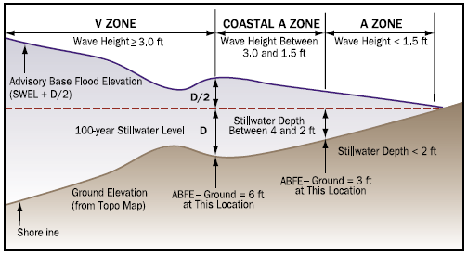
FEMA
Coastal Cross Section
Notes:
FEMA uses the datasets for NFIP Mapping for communities.

Slide 4
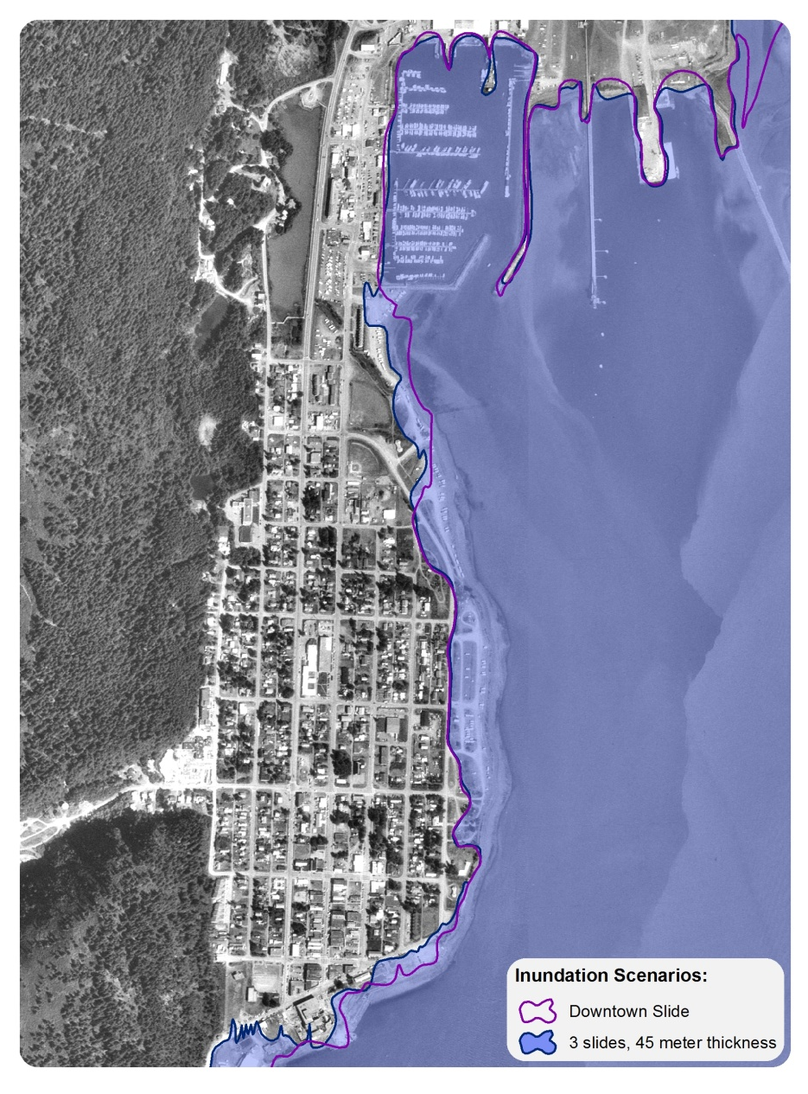

Inundation Maps UAF GI

Slide 5
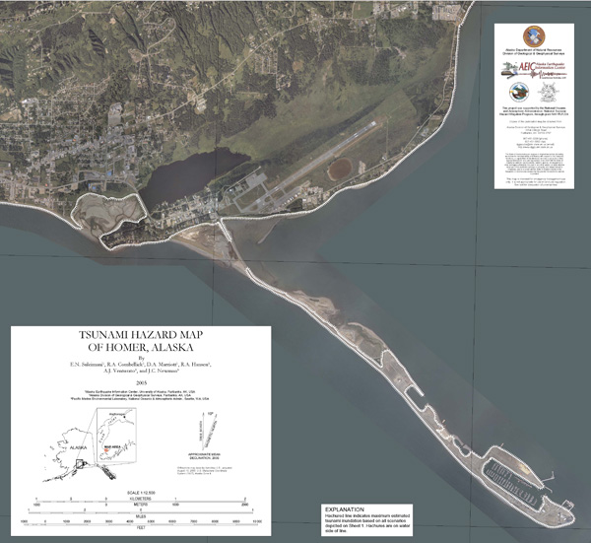
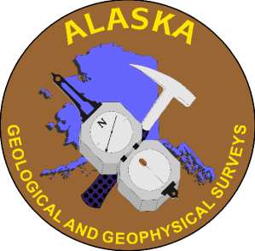
Tsunami Inundation Maps
Homer, AK
Hazard Mapping
AK DGGS

Slide 6
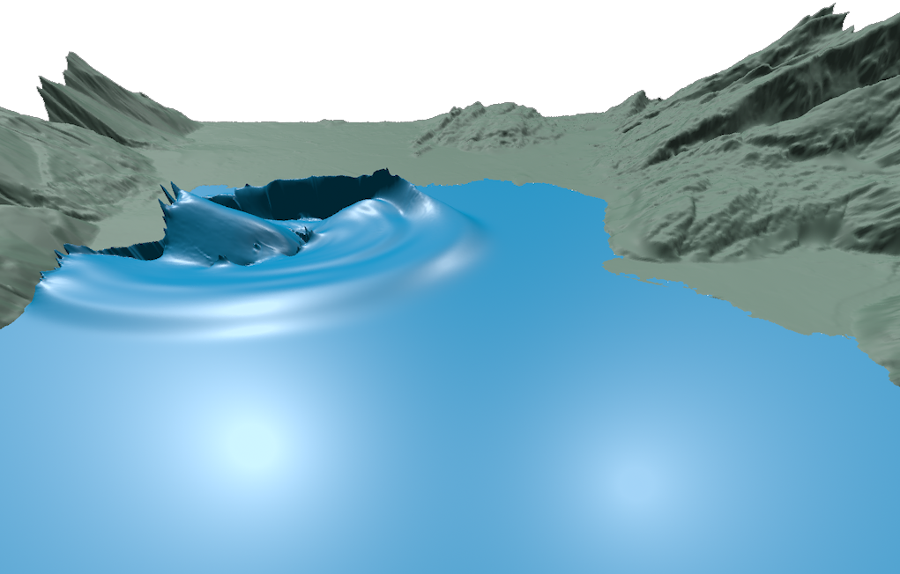
Modeling – UAF GI
Numerical Wave Run-up Modeling

Slide 7
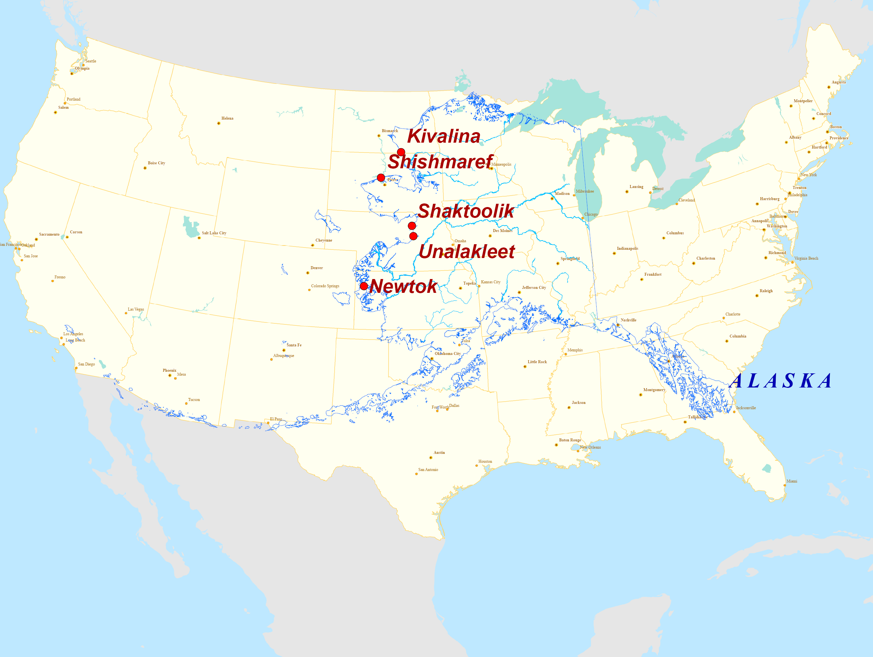
Increasing Coastal and River Erosion

Slide 8
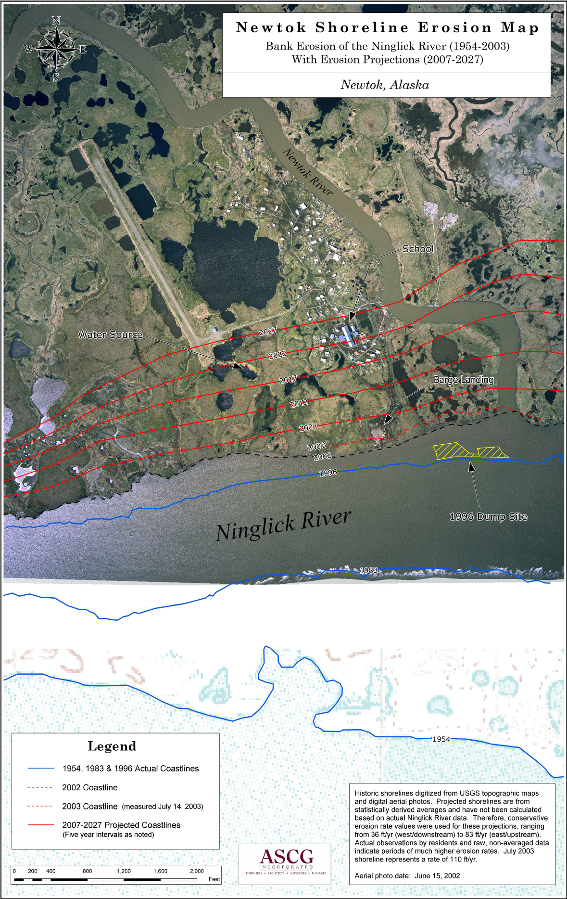
Notes:
Slide 14b: same for Kivalina
Conservative projections of shoreline erosion of 110’ per year.
Sea Storm Erosion - Kivalina

Slide 9
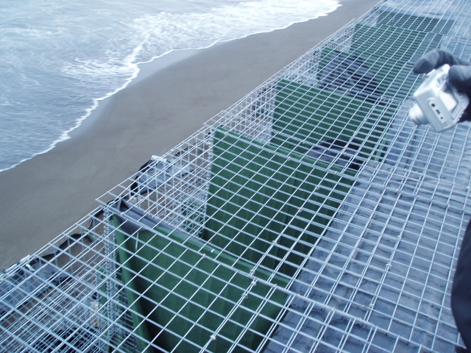
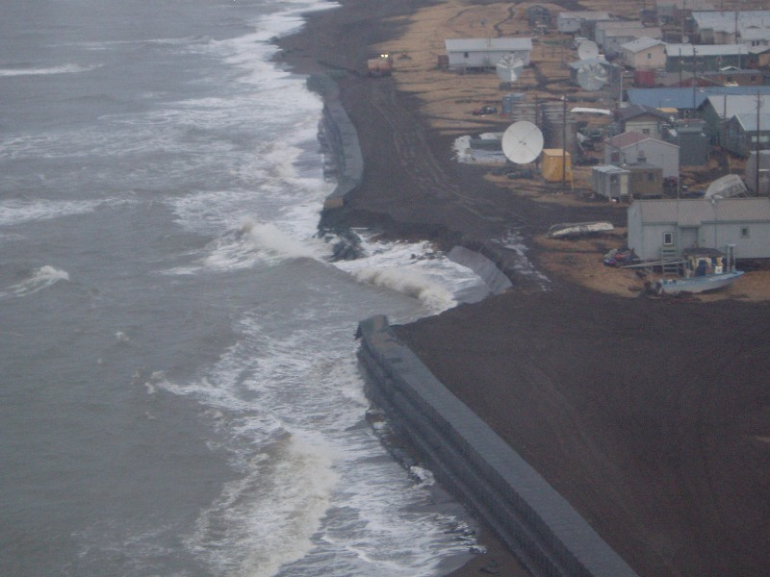
2006 Sea Storm Erosion:
High Tech Designed Prevention
Subsequent Low Tech Damage
Notes:
Kivalina

Slide 10
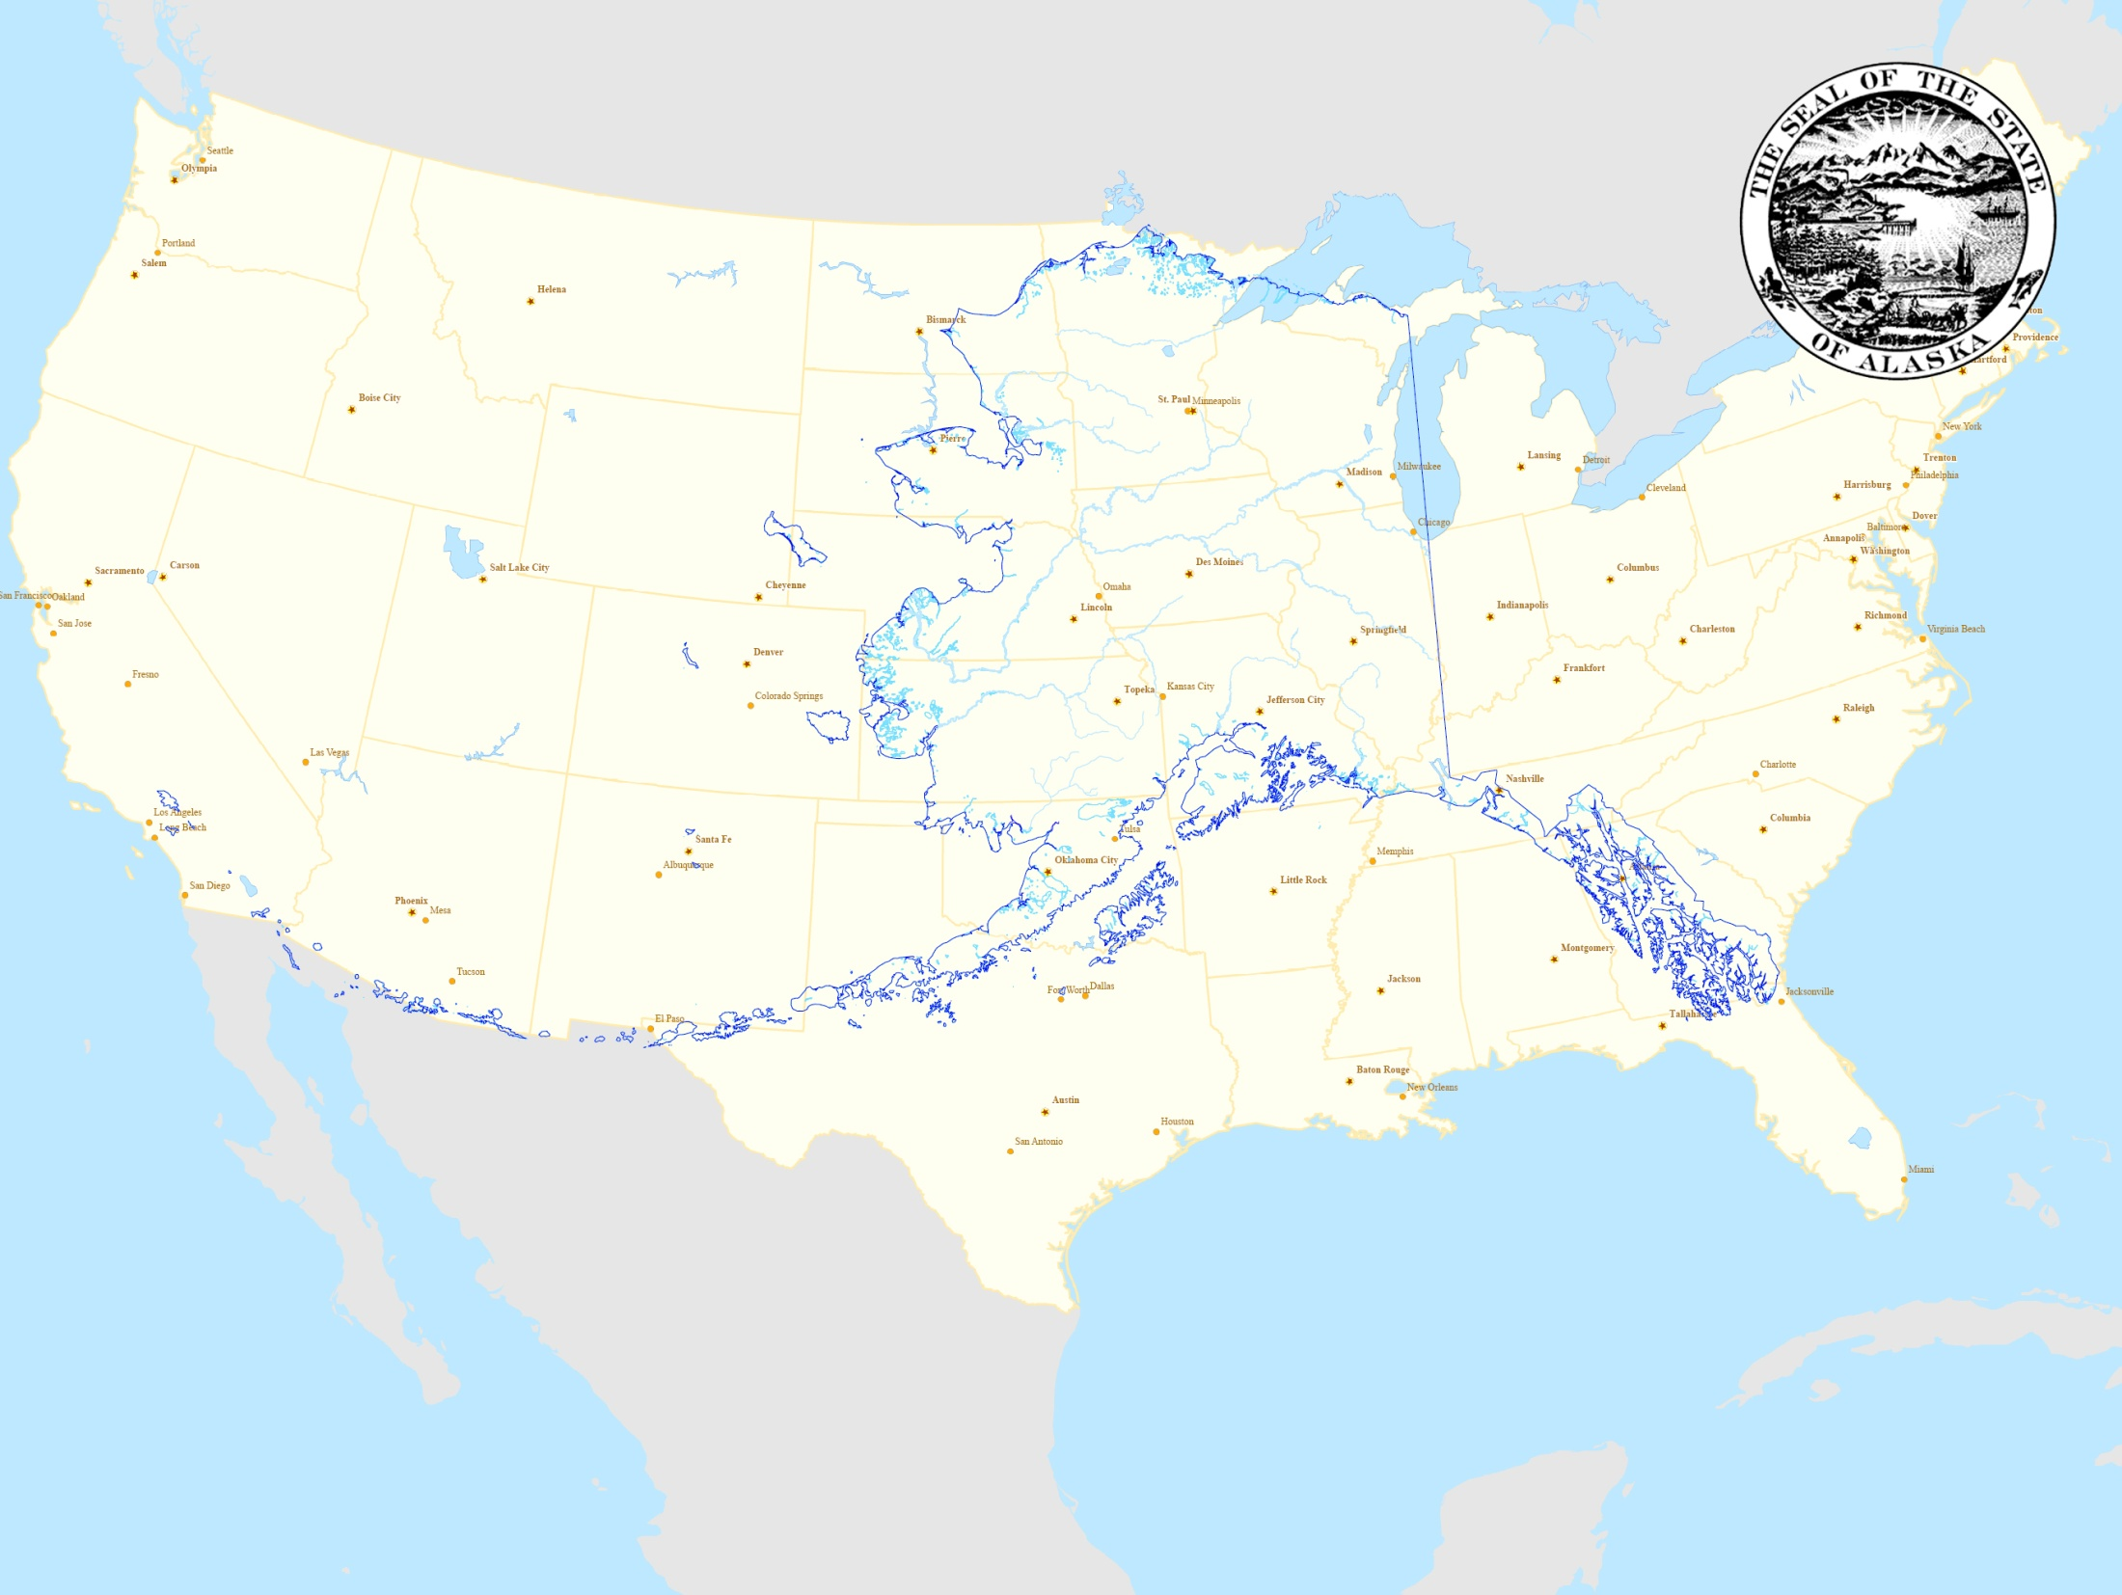
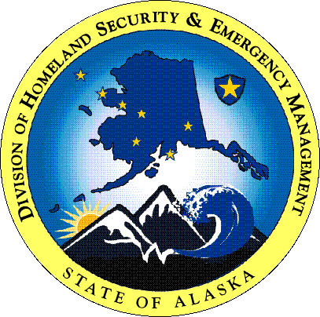
Mike O’Hare
Mike.Ohare@alaska.gov
907-428-7066

